Slide 1

Spring Data
Course Introduction
SoftUni Team
Technical Trainers
Software University
https://softuni.bg

Slide 2
Table of Contents
Course Objectives & Program
The Trainers Team
Course Organization
Homework
Exam
Resources
2

Slide 3
Questions
sli.do #Java-DB

Slide 4


Course Objectives & Program
Spring Data

Slide 5


Course Objectives
The Spring Data course covers
Connecting to local DB instance
ORM, Hibernate and Spring Data
Code-First implementations
Programming Patterns
Working with data in other formats (XML, JSON)

Slide 6



Course Topics
Introduction to DB Applications
Creating Custom ORM Framework
Introduction to Hibernate
Entity Relations in Hibernate
Introduction to Spring Data

Slide 7
Course Topics (2)
Spring Data Advanced Querying
Spring Data Auto Mapping Objects
JSON Processing
XML Processing
Creating Large DB
Exam Preparations

Slide 8

The Trainers Team

Slide 9
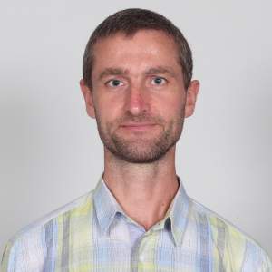
Trainers Team
Trayan Iliev
Developer of end-to-end reactive full-stack applications and services using ES, TypeScript, Angular, React and Vue.js clients, and Spring 5, Reactor, Kafka, Pulsar, RabbitMQ, Express and Java EE back-ends.
15+ years of software development experience and 12+ years experience as enterprise IT trainer - https://www.linkedin.com/in/trayaniliev/.
CEO of IPT – Intellectual Products & Technologies - http://iproduct.org/ – training and consultancy company, focused on novelties in front-end and REST/ gRPC/ GraphQL backend development – reactive UI, end-to-end reactive programming, distributed event stream processing, real-time micro-service architectures.
Has presentations on local developer conferences such as Voxxed Days, jPrime, jProfessionals, BGOUG, on topics like Spring 5, Reactor, SOA & REST, CDI, Java EE, React, Angular, Ionic, RxJS, reactive and high-performance java
He is robotics / smart-things/ IoT enthusiast and organizes RoboLearn hackathons in Sofia.

Slide 10
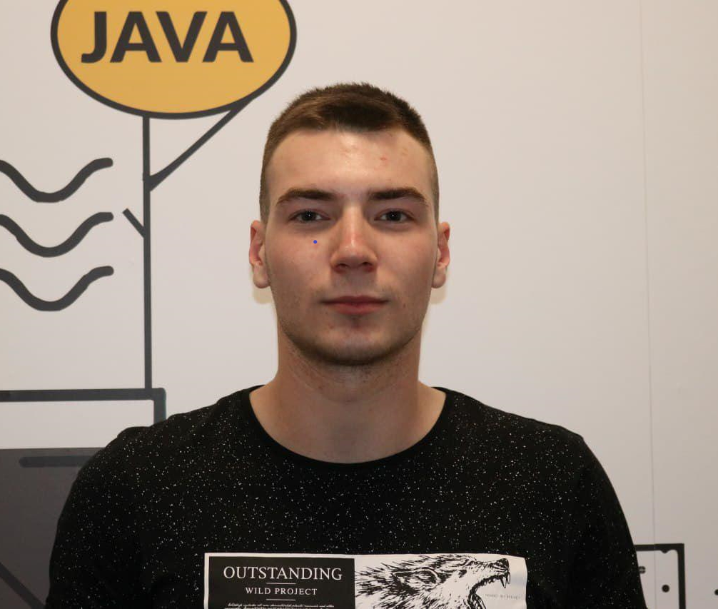
Trainers Team
Konstantin Mitev
Java Developer @ Madara Invest
Top performing student at SoftUni
Fluent with Spring and React frameworks
Interested in Java and JavaScript

Slide 11
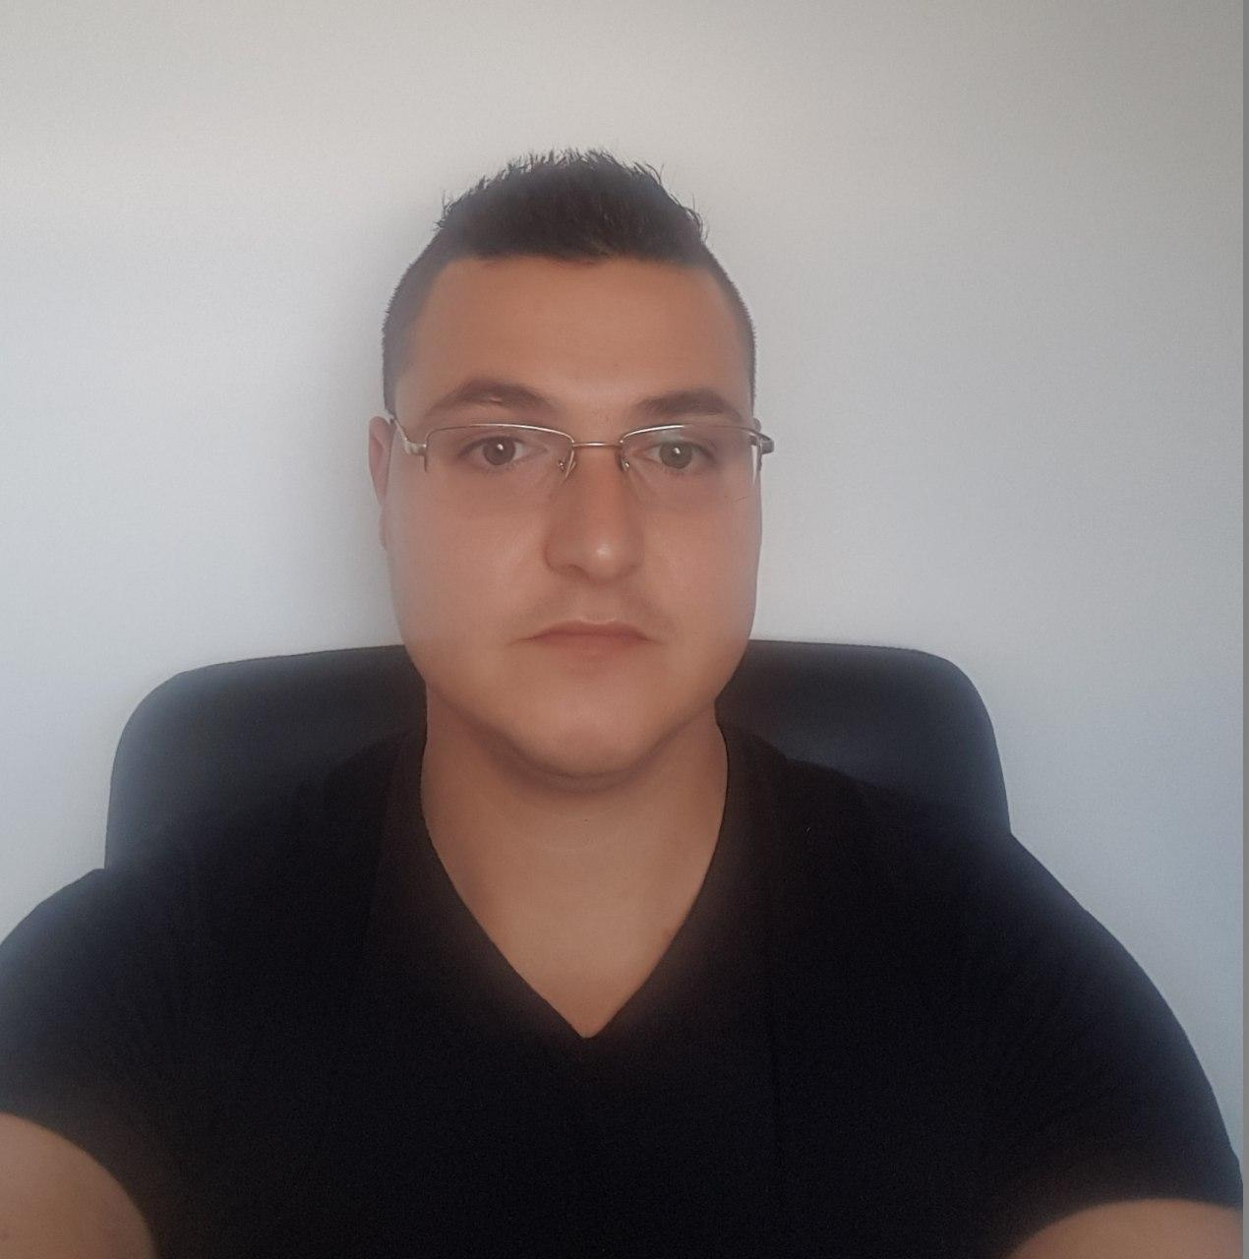
Trainers Team
Chavdar Mitkov
Technical Trainer @ SoftUni
Top performing student
Experience with MySQL ,
Hibernate, Spring
Interested in Java, JavaScript, Angular

Slide 12

Course Organization

Slide 13
DB Fundamentals Module – Timeline
13-Jan-2020
13-Feb-2020
29-Mar-2020
MySQL
4 weeks * 4 times / week
9 credits
Start: 13-Jan-2020 Final exam: 09-Feb-2020
Spring Data
7 weeks * 4 times / week
15 credits
Start: 13-Feb-2020
Final exam: 29-Mar-2020
Re-Take Exams
TBA

Slide 14



Scoring System for the Course
Theoretical exam 5%
Presence in class 5%
Evaluation
Homework 5%
Exam 90%
14

Slide 15

Homework Assignments & Exercises
Your homework is mainly work in class!
Lesson days → slides + live demos + exercises
Exercise days → only exercises
How to submit your homework?
Submitted on the course page in softuni.bg
Exam - Project

Slide 16
Resources
What We Need Additionally?

Slide 17


Java DB Course Web Site, Forum and FB Group
Official web site:
Official discussion forum:
https://softuni.bg/trainings/2612/spring-data-february-2020
https://softuni.bg/forum/categories/78/databases-advanced-hibernate

Slide 18


The DB Basics MySQL Slides and Videos
All lecture slides, videos, homework assignments, projects and other resources are open content, available for free
Visit the course web site to access the course resources

Slide 19



Learn to Search in Internet
The course assignments require to search in Internet
This is an important part of the learning process
Some exercises intentionally have no hints
Learn to find solutions!
Software development includes everyday searching and learning
No excuses, just learn to study!
Developers learn new technologies, tools, languages every day!

Slide 20
Questions?
Notes:
20

Slide 21












SoftUni Diamond Partners

Slide 22




SoftUni Organizational Partners

Slide 23
Trainings @ Software University (SoftUni)
Software University – High-Quality Education, Profession and Job for Software Developers
softuni.bg, softuni.org
Software University Foundation
softuni.foundation
Software University @ Facebook
facebook.com/SoftwareUniversity
Software University Forums
forum.softuni.bg
23
Notes:
23

Slide 24

License
This course (slides, examples, demos, exercises, homework, documents, videos and other assets) is copyrighted content
Unauthorized copy, reproduction or use is illegal
© SoftUni – https://softuni.org
© Software University – https://softuni.bg
Notes:
24

